Slide 1
Indexing

Slide 2
Indexing
A SQL index is a quick lookup table for finding records users need to search frequently.
An index is small, fast, and optimized for quick lookups.
It is very useful for connecting the relational tables and searching large tables.
Simply put, an index is a pointer to data in a table.
An index helps to speed up SELECT queries and WHERE clauses, but it slows down data input, with the UPDATE and the INSERT statements.
Indexes can be created or dropped with no effect on the data.
SQL Server supports several types of indexes but one of the most common types is the clustered index.
This type of index is automatically created with a primary key.

Slide 3
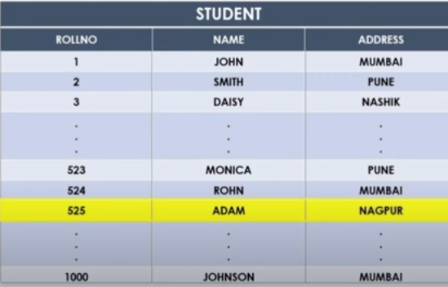
Why we need Indexing in DBMS?
Suppose, we want to search record of student whose roll no. is 525 from 1000 records in a table.
Query: select * from student where rollno=525;
It will search 524 records in a table then we get 525th record.
Time consuming

Slide 4
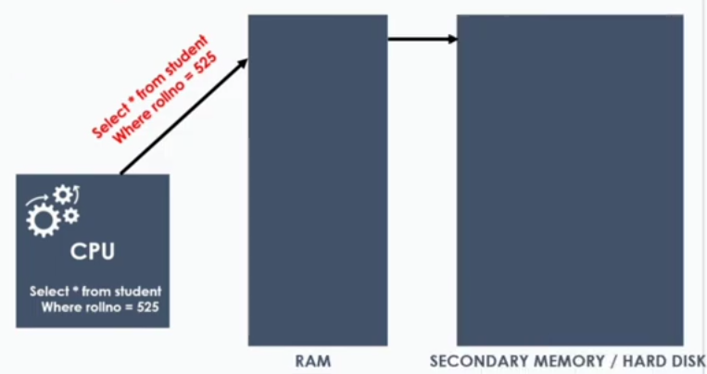
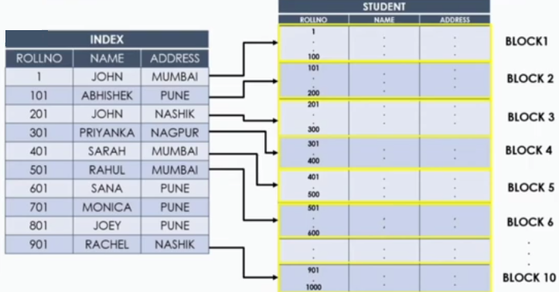
Solution: Indexing

Slide 5
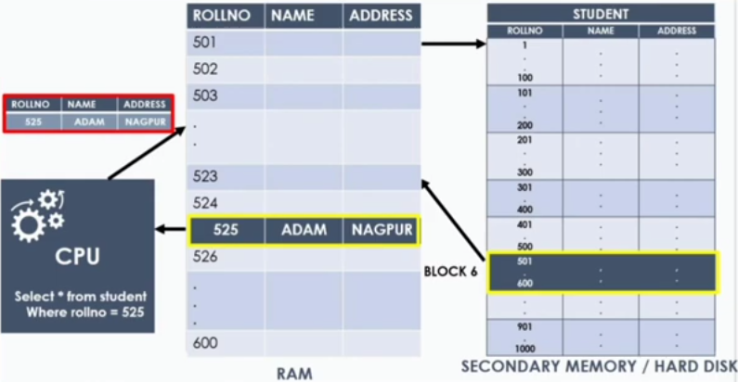

Slide 6

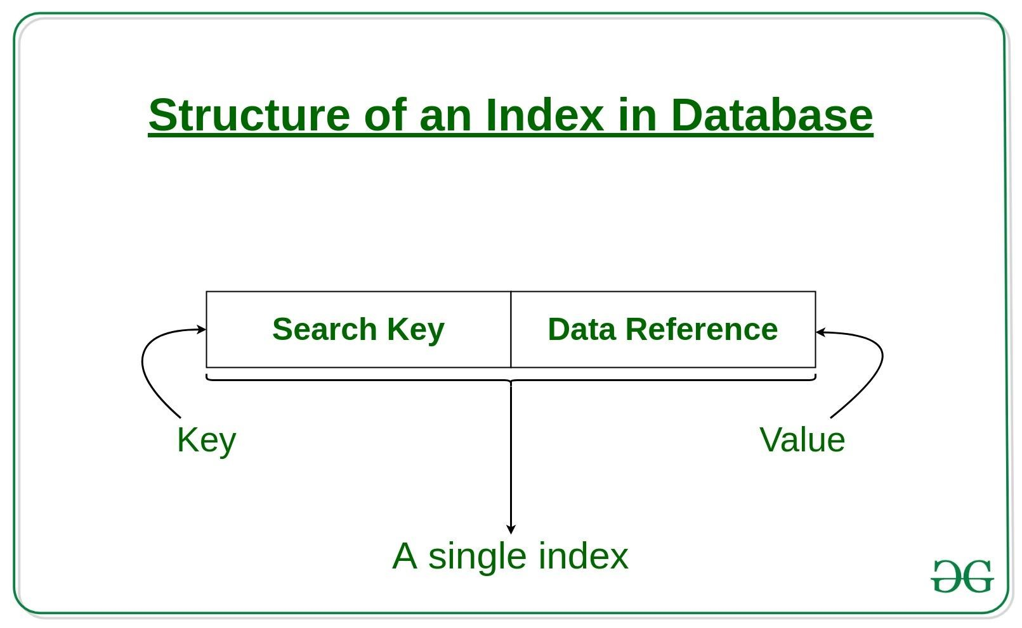
Indexing is a way to optimize the performance of a database by minimizing the number of disk accesses required when a query is processed.
It is a data structure technique which is used to quickly locate and access the data in a database.

Slide 7
The indexing has various attributes:
Access Types: This refers to the type of access such as value based search, range access, etc.
Access Time: It refers to the time needed to find particular data element or set of elements.
Insertion Time: It refers to the time taken to find the appropriate space and insert a new data.
Deletion Time: Time taken to find an item and delete it as well as update the index structure.
Space Overhead: It refers to the additional space required by the index.

Slide 8
Ordered indices
Ordered index similar to index in a textbook
An index access structure is usually defined on a single field of a file, called an indexing field (or indexing attribute).
The index typically stores each value of the index field along with a list of pointers to all disk blocks that contain records with that field value.
There are several types of indexes.
Primary Index
Clustering Index
Secondary Index
Notes:
A database field refers to a set of values arranged in a table and has the same data type. A field is also known as a column or attribute.
Like a single box.

Slide 9
A primary index is specified on the ordering key field of an ordered file of records.
An ordering key field is used to physically order the file records on disk, and every record has a unique value for that field.
If the ordering field is not a key field—that is, if numerous records in the file can have the same value for the ordering field— another type of index, called a clustering index, can be used.
The data file is called a clustered file in this latter case. Notice that a file can have at most one physical ordering field, so it can have at most one primary index or one clustering index, but not both.
A third type of index, called a secondary index, can be specified on any nonordering field of a file.
A data file can have several secondary indexes in addition to its primary access method.

Slide 10
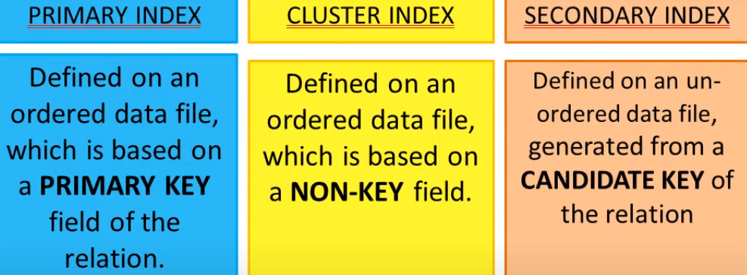
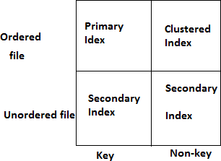
Types of indices

Slide 11
Indexes may be dense or sparse
Dense index has an index entry for every search key value in the data file
Sparse index has entries for only some search values

Slide 12
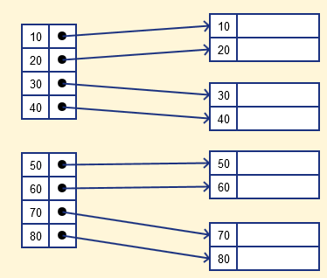
Dense Index
In dense index, there is an index record for every search key value in the database.
This makes searching faster but requires more space to store index records itself.

Slide 13
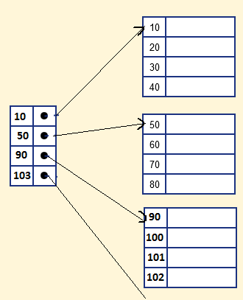
Sparse Index
It is an index record that appears for only some of the values in the file.
Sparse Index helps you to resolve the issues of dense Indexing in DBMS.
In this method of indexing technique, a range of index columns stores the same data block address, and when data needs to be retrieved, the block address will be fetched.
However, sparse Index stores index records for only some search-key values.
It needs less space, less maintenance overhead for insertion, and deletions but It is slower compared to the dense Index for locating records

Slide 14
Primary index
A primary index is an ordered file whose records are of fixed length with two fields.
The first field is of the same data type as the ordering key field—called the primary key—of the data file,
and the second field is a pointer to a disk block (a block address).
There is one index entry (or index record) in the index file for each block in the data file.
Each index entry has the value of the primary key field for the first record in a block and a pointer to that block as its two field values.
We will refer to the two field values of index entry i as <K(i),P(i)>

Slide 15
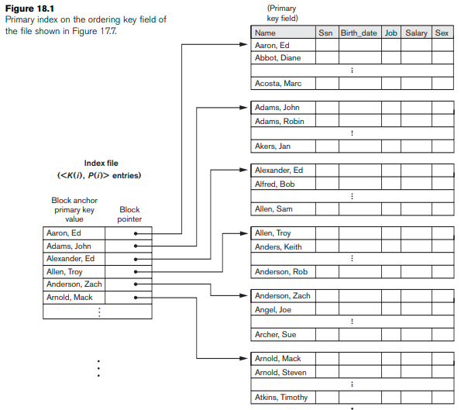

Example
To create a primary index on the ordered, we use the Name field as primary key, because that is the ordering key field of the file (assuming that each value of Name is unique).
Each entry in the index has a Name value and a pointer. The first three index entries are as follows:

Slide 16
Cluster index
Sometimes the index is created on non-primary key columns which may not be unique for each record.
In this case, to identify the record faster, we will group two or more columns to get the unique value and create index out of them.
This method is called a clustering index.
A clustered index can be defined as an ordered data file.
The records which have similar characteristics are grouped, and indexes are created for these group.
Ordered file with two fields
Same type as clustering field
Disk block pointer

Slide 17
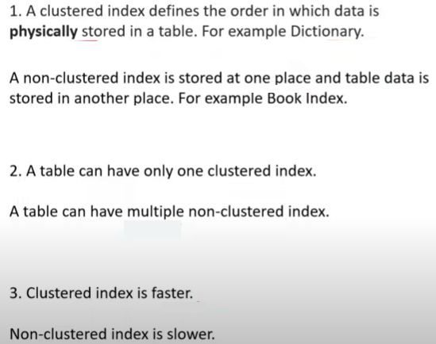
Difference between Cluster and Non-cluster Index

Slide 18
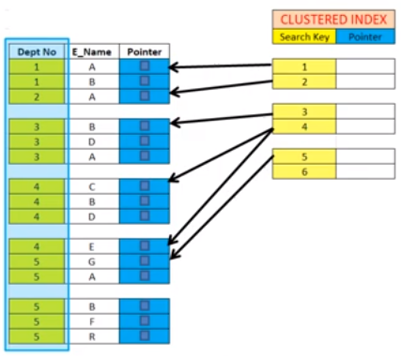
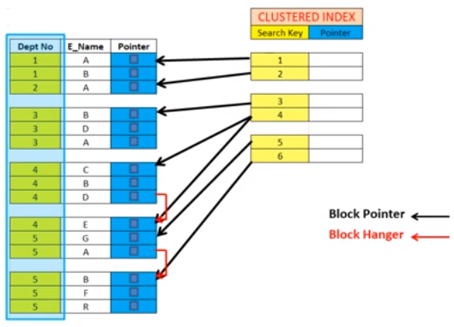
Example

Slide 19
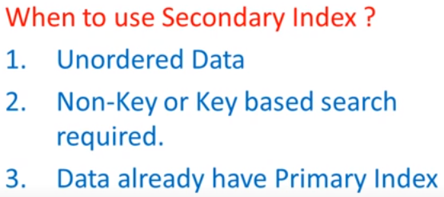
Secondary/Non-cluster Indexing

Slide 20
Cntd..
The secondary Index in DBMS can be generated by a field which has a unique value for each record, and it should be a candidate key.
It is also known as a non-clustering index.
If the mapping size grows then fetching the address itself becomes slower.
In this case, the sparse index will not be efficient. To overcome this problem, secondary indexing is introduced.
In secondary indexing, to reduce the size of mapping, another level of indexing is introduced.
In this method, the huge range for the columns is selected initially so that the mapping size of
the first level becomes small.
Then each range is further divided into smaller ranges.
The mapping of the first level is stored in the primary memory, so that address fetch is faster.
The mapping of the second level and actual data are stored in the secondary memory (hard disk).

Slide 21
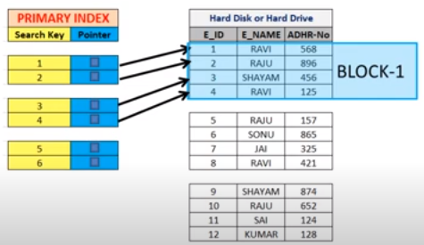
Example

Slide 22
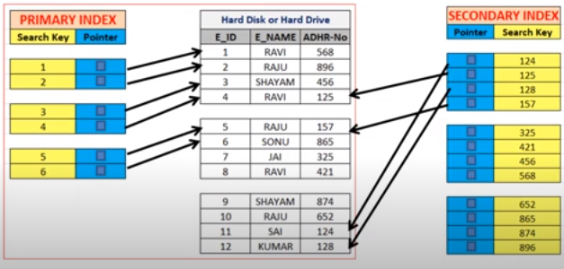
Secondary index on key-attribute

Slide 23

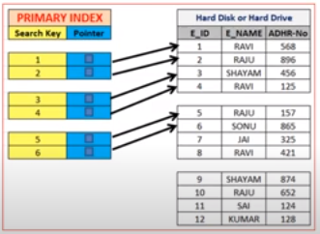
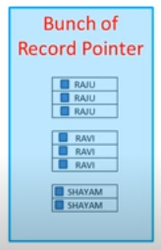
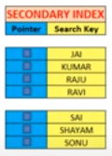
Secondary index on non-key attribute

Slide 24
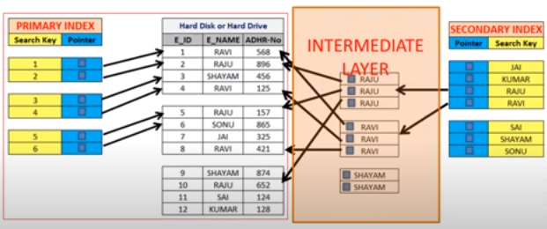

Slide 25
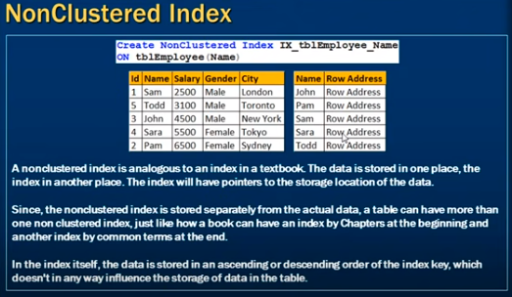
NonClustered Index

Slide 26
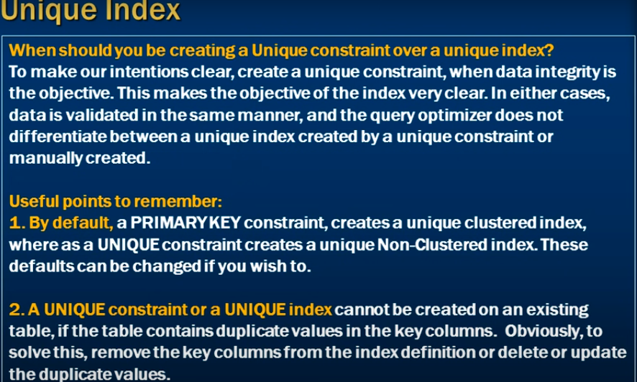

Slide 27
Multilevel index
Index records comprise search-key values and data pointers.
Multilevel index is stored on the disk along with the actual database files.
As the size of the database grows, so does the size of the indices.
There is an immense need to keep the index records in the main memory so as to speed up the search operations.
If single-level index is used, then a large size index cannot be kept in memory which leads to multiple disk accesses.
Multi-level Index helps in breaking down the index into several smaller indices in order to make the outermost level so small that it can be saved in a single disk block, which can easily be accommodated anywhere in the main memory.

Slide 28
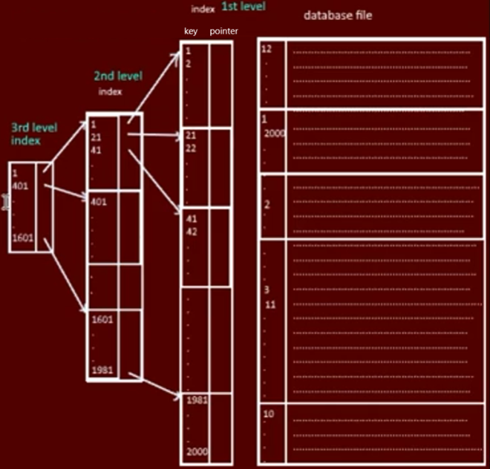
Example

Slide 29
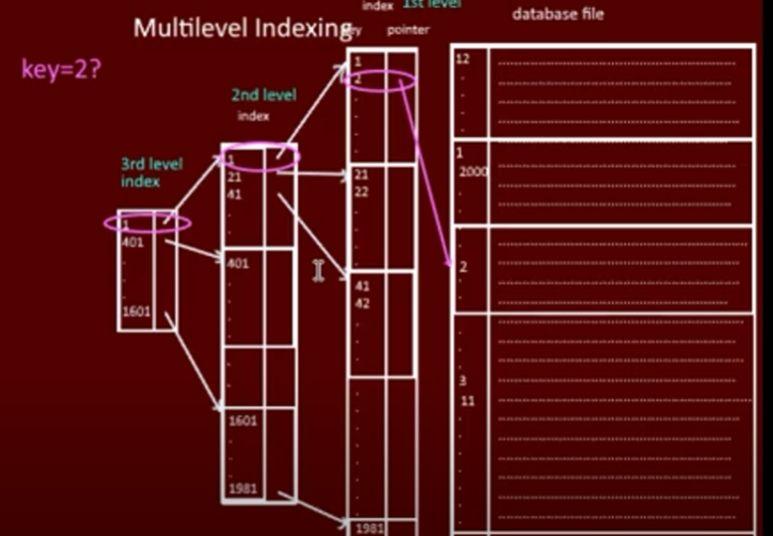
Searching in multilevel indexing

Slide 30
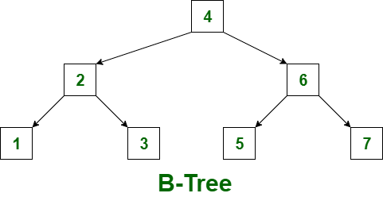
B-Tree
B-Tree is known as a self-balancing tree as its nodes are sorted in the inorder traversal.
In B-tree, a node can have more than two children.
B-tree has a height of logM N (Where ‘M’ is the order of tree and N is the number of nodes).
And the height is adjusted automatically at each update. In the B-tree data is sorted in a specific order, with the lowest value on the left and the highest value on the right.

Slide 31
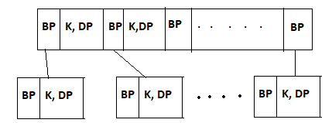
The structure of node in Btree is same at all level. (root,intemediate,leaf)
BP-Block Pointer
K-key
DP-Data Pointer
Properties:
If order of tree=m
Max no.of children =m
Min no.of keys=m-1
Min no.of children =
Min No. of keys= - 1

Slide 32
Example
https://www.youtube.com/watch?v=KnXohGgIpQU
https://www.youtube.com/watch?v=jpS8BLb8BgI

Slide 33
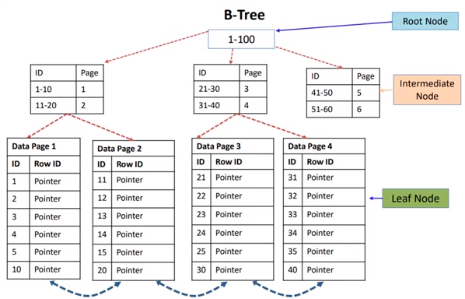
B-Tree

Slide 34
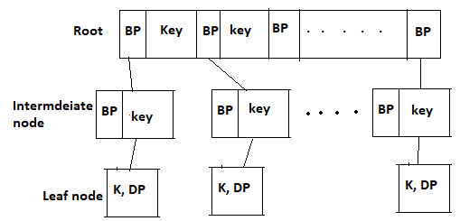
B⁺ Tree
A B⁺ tree is a balanced binary search tree that follows a multi-level index format.
The leaf nodes of a B⁺ tree denote actual data pointers.
B⁺ tree ensures that all leaf nodes remain at the same height, thus balanced.
Additionally, the leaf nodes are linked using a link list; therefore, a B⁺ tree can support random access as well as sequential access.

Slide 35
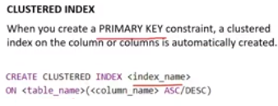

Create index
Syntax:
CREATE INDEX index_name
ON table_name (column1, column2, ...);
CREATE UNIQUE INDEX
Duplicate values are not allowed.
Syntax:
CREATE UNIQUE INDEX index_name
ON table_name (column1, column2, ...);
DROP INDEX
The DROP INDEX statement is used to delete an index in a table.
ALTER TABLE table_name DROP INDEX index_name;

Slide 36
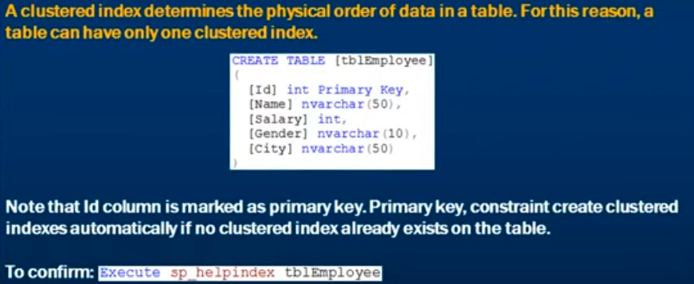
Clustered index

Slide 37
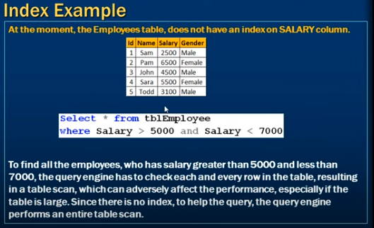
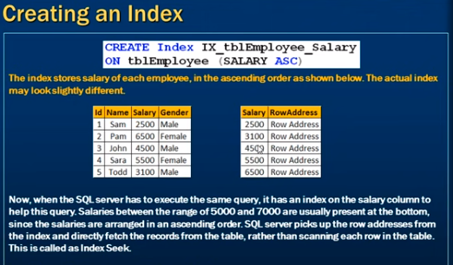

Slide 38


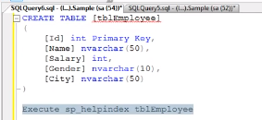
Example
Cluster index

Slide 39
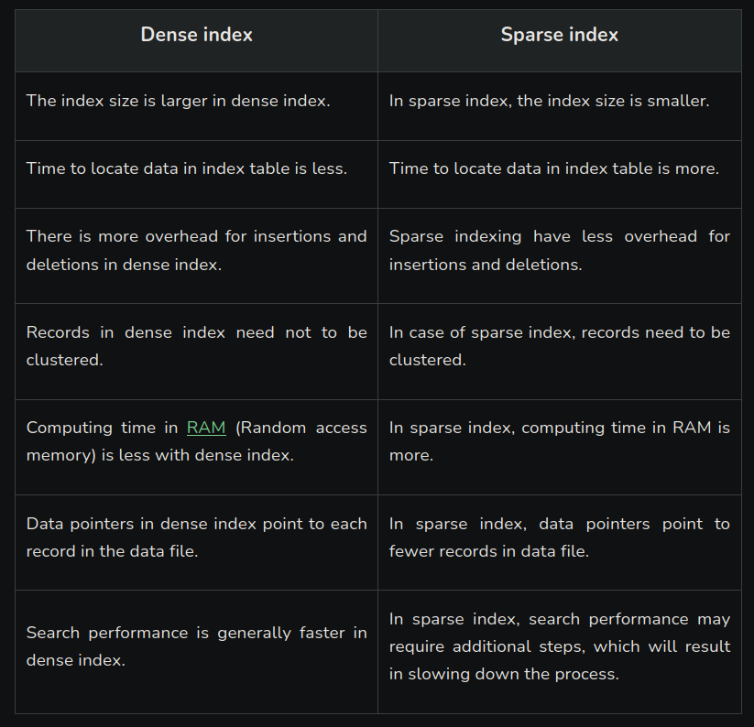

Slide 40
